Slide 1
Covid 19 Data Analysis
Sami Elkhayri, Martin Kaminskyj,Muzznah Ansari, Femi Adeleke, Patricia Lan
September 14, 2020

Slide 2
Topic Selection
Our group chose to perform data analysis on coronavirus disease of 2019 (COVID-19), because it is a current global issue with extensive socio economic impact, and variety of available public data. The insight obtained from this analysis will add to the existing knowledge of the disease and support the ongoing effort to combat its spread.

Slide 3
Questions We Hope to Answer
What is the correlation between Population and covid-cases/death?
What is the correlation between Population density and covid-cases/death?
What is the correlation between Government response and covid-cases/death?
What is the correlation between GDP and covid-cases/death?
What is the correlation between aging population and covid-cases/death?
What features can help predict future covid-cases and deaths with r2>0.85?

Slide 4
Data Source(s)
Oxford University Blavatnik School of Government -Indices that categorized government responses to COVID-19
Google Community Mobility Reports - Changes in people's mobility
Our World in Data and Esri Canada- Medical data on COVID-19 (e.g. number of confirmed cases and deaths).

Slide 5
Description of the Data Exploration Phase
The Government_Regulation_df has 185 countries and covid_stats_df has 212.
Not all countries from one CSV were present in the other CSV and vise versa
45140 null values were observed in the government dataset
On the null values, we had to determine if using the preceding number was a better option than filling with zeros
Columns with full nulls were dropped
All new columns were made zero while total columns were made to reflect the prior rows
Covid_stats dataset’s date range:2019-12-31 to 2020-08-31
Government_Regulation_df date range: 2020-01-01 to 2020-08-31
Created new columns -Percentage change and Percentage of population
With all changes, we had to create a for loop to ensure all countries were treated independently

Slide 6
Description of the Analysis Phase
Compared the indices columns in the data using linear regression plot .See link below
https://colab.research.google.com/drive/1-3Rk4Qijq22iXDVvgPsxzgJQM0gctnRQ?authuser=1
Remaining variables were also plotted using linear regression.See link below:
https://colab.research.google.com/drive/1cfhOhb9j8zs3h-GZBSdmzi3UB-JjpHtz?authuser=1#scrollTo=7Wp68uKGsako
Analyzed top 5 countries that took the slowest to incorporate government response from min -> max index
Analyzed top 5 countries that took the least amount of time to incorporate government response from min -> max index
Performed Canada & US ranking for length of time to incorporate government response min -> max
Correlated average mobility (going outdoors or staying at home) with Max Total Cases & Max Total Deaths (% of Pop)
Compared various models (SVR, Random Forest & Neural Network) to determine which best predict data without overfitting
Determined feature importance to identify which variable is more related to the target variable

Slide 7
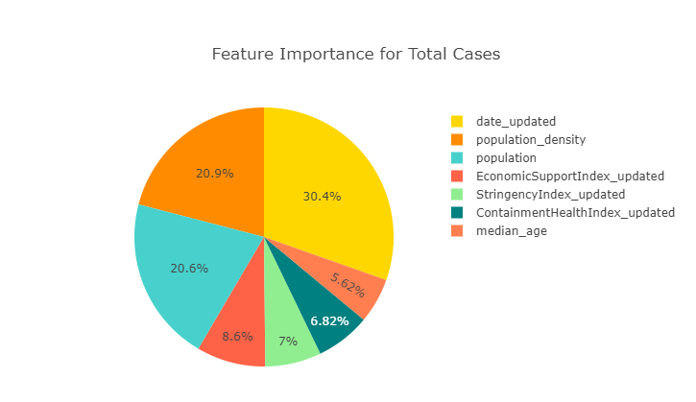
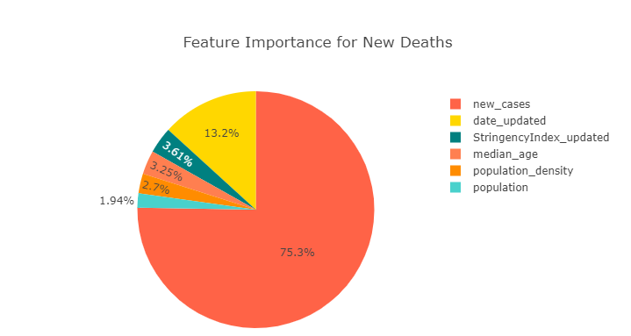
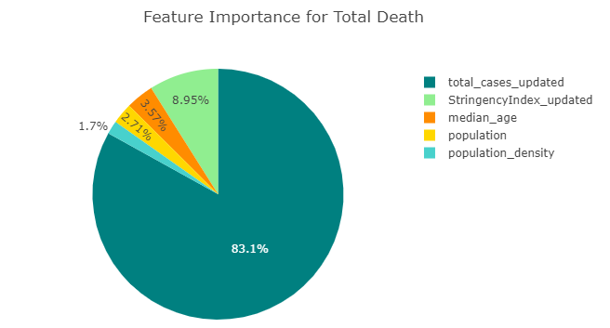
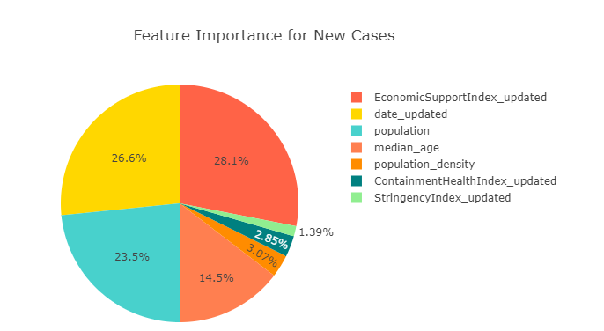
Data Analysis
Feature Importance

Slide 8
Conclusion(s)
Findings based on Question 1
High government response (specifically stringency & health) | Longer time from first case to max new cases
High median age | High case & death counts (3 month after first case)
High population density | Longer time from min to max government response Longer time from government response to first case
High avg. tests per day (% of pop) | High rate of increase of total tests (% of pop)

Slide 9
Conclusion(s)
Findings based on Question 1
High economic support | High government response High median age
High average test per day | -High rate of increase of total tests (% of pop) -High max new cases -High total cases (3 month after first case)

Slide 10
Conclusion(s)
Findings based on Question 2
High mobility: Outdoors | Low government response (mainly S & H) Low max new cases & new deaths
High mobility: Residential | High government response (mainly S & H) High max new cases & new deaths

